Slide 1
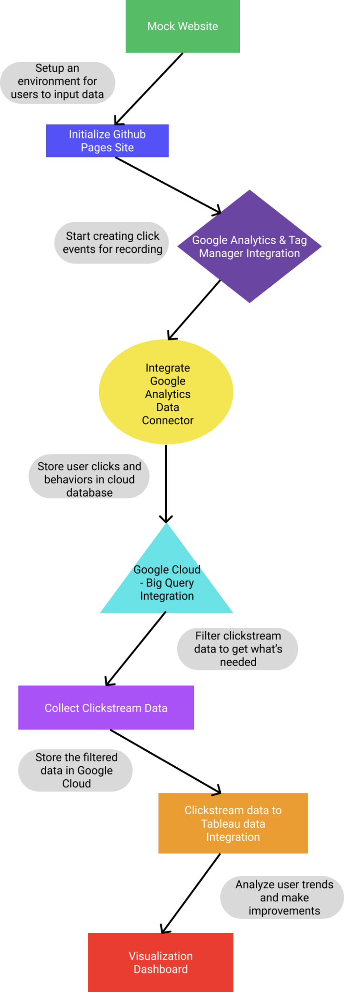
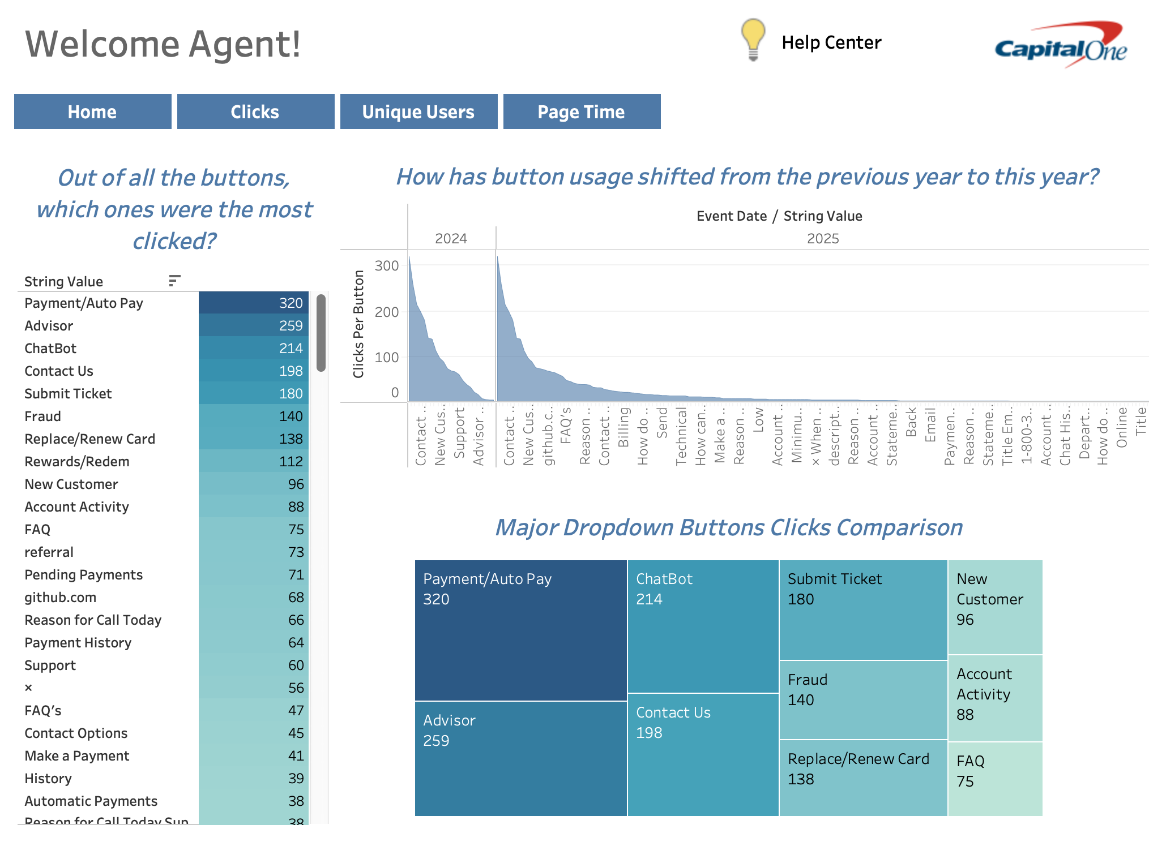
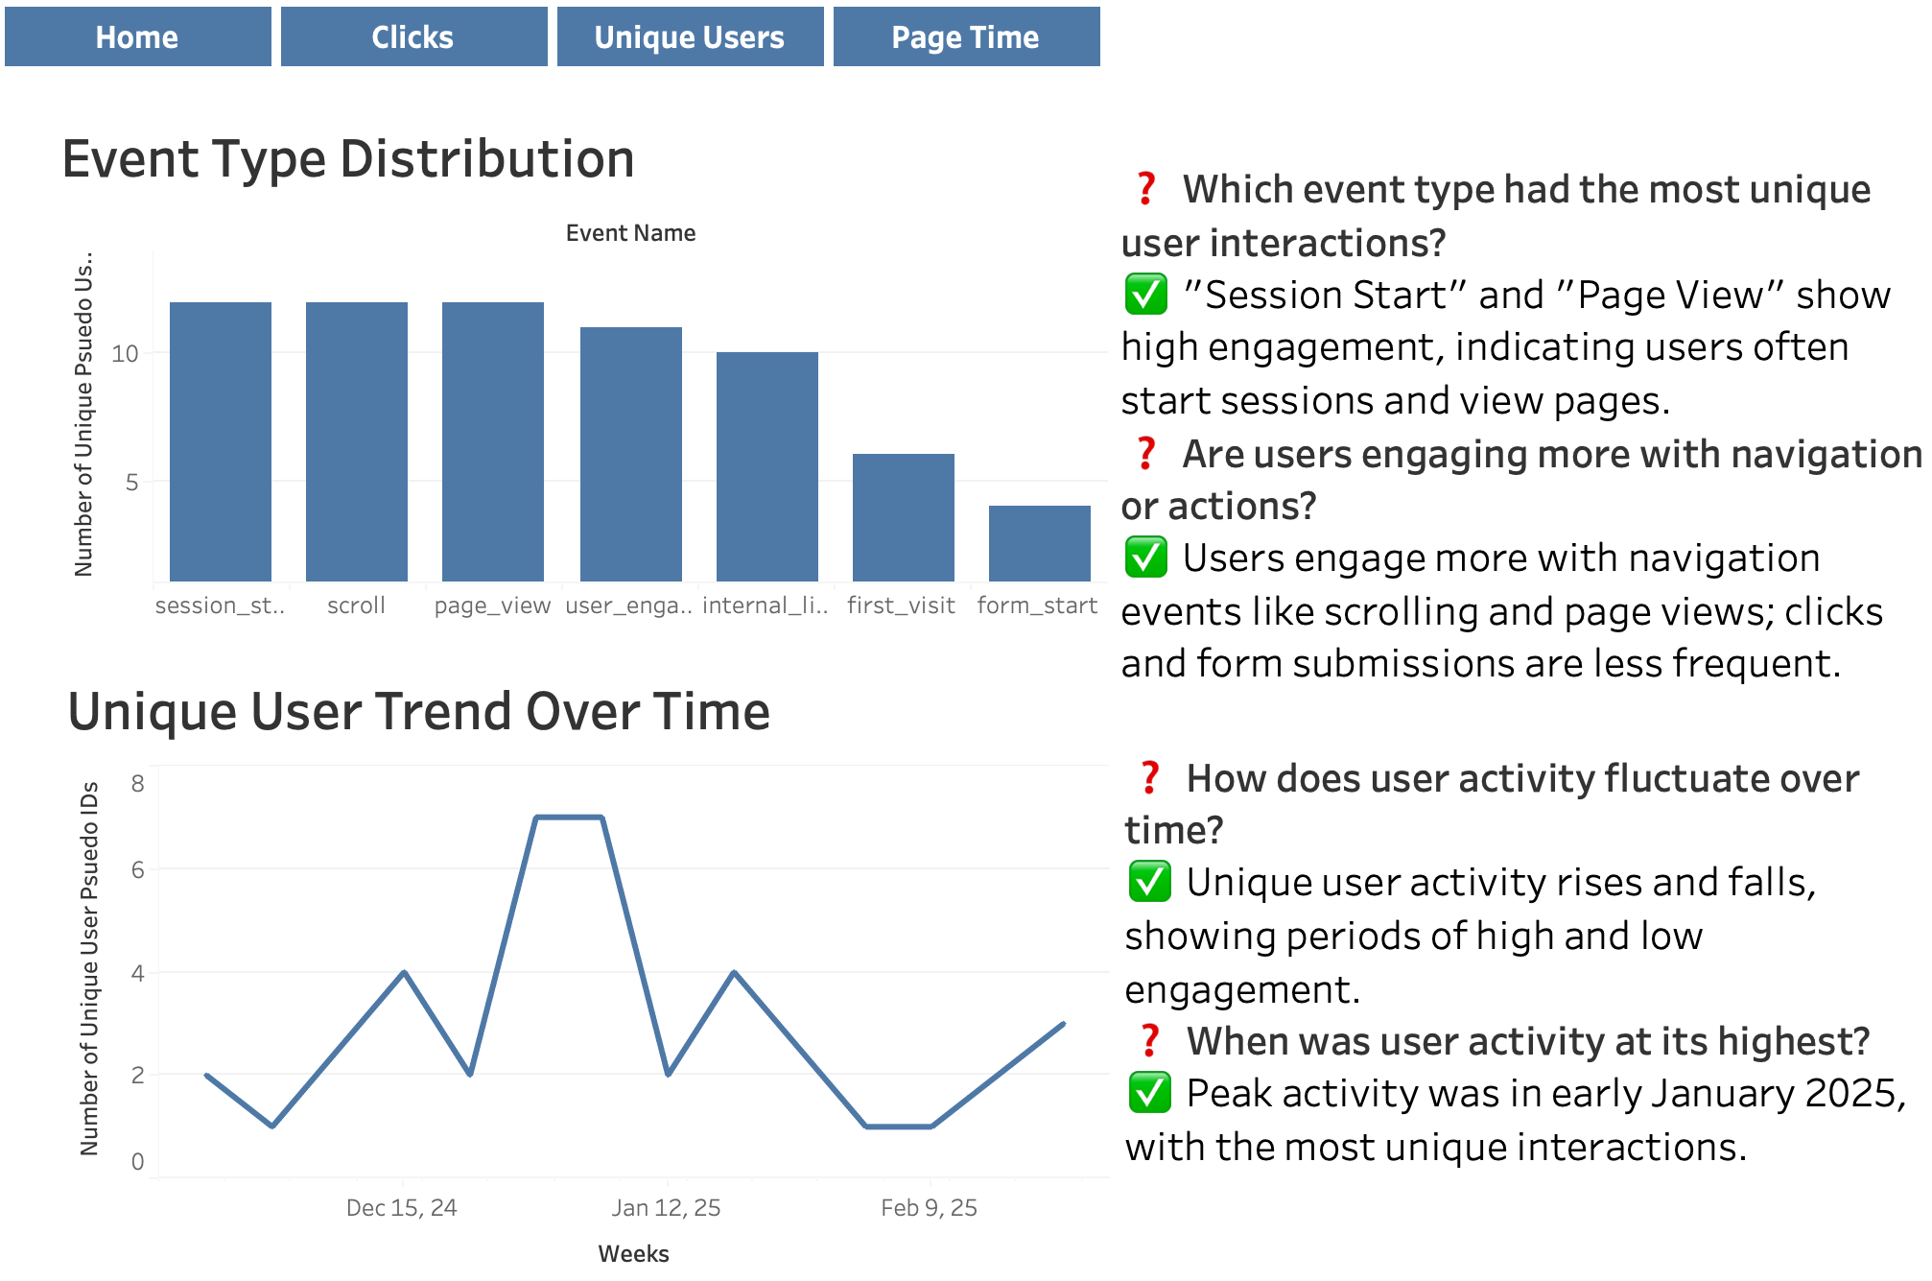
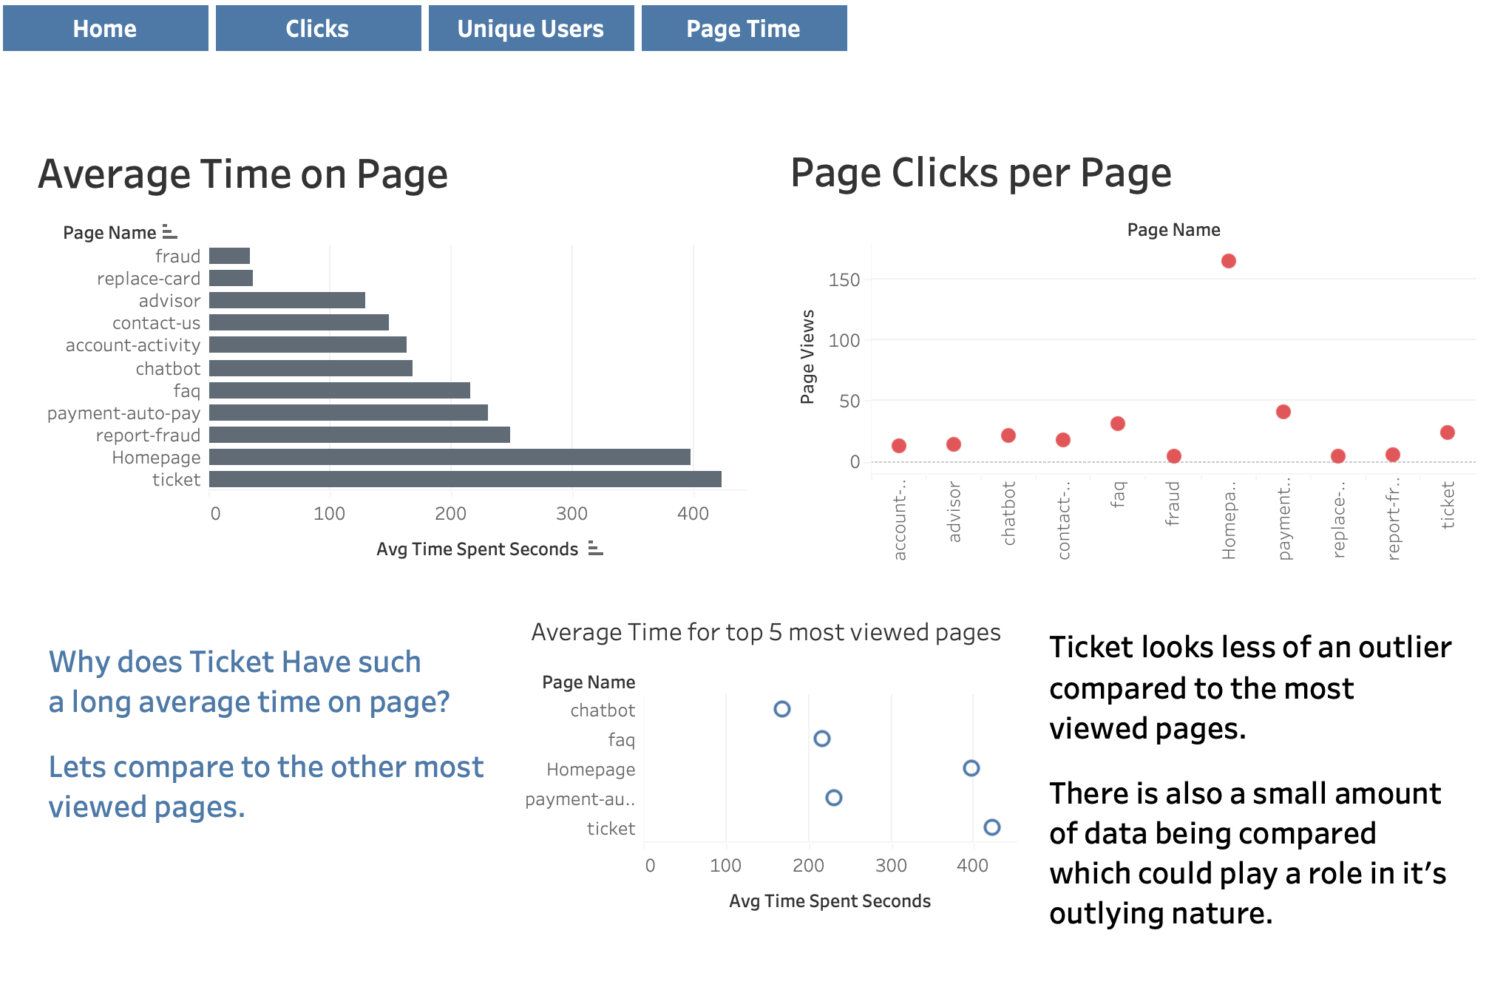

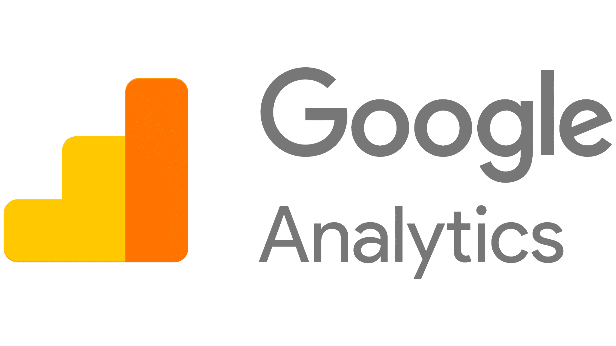

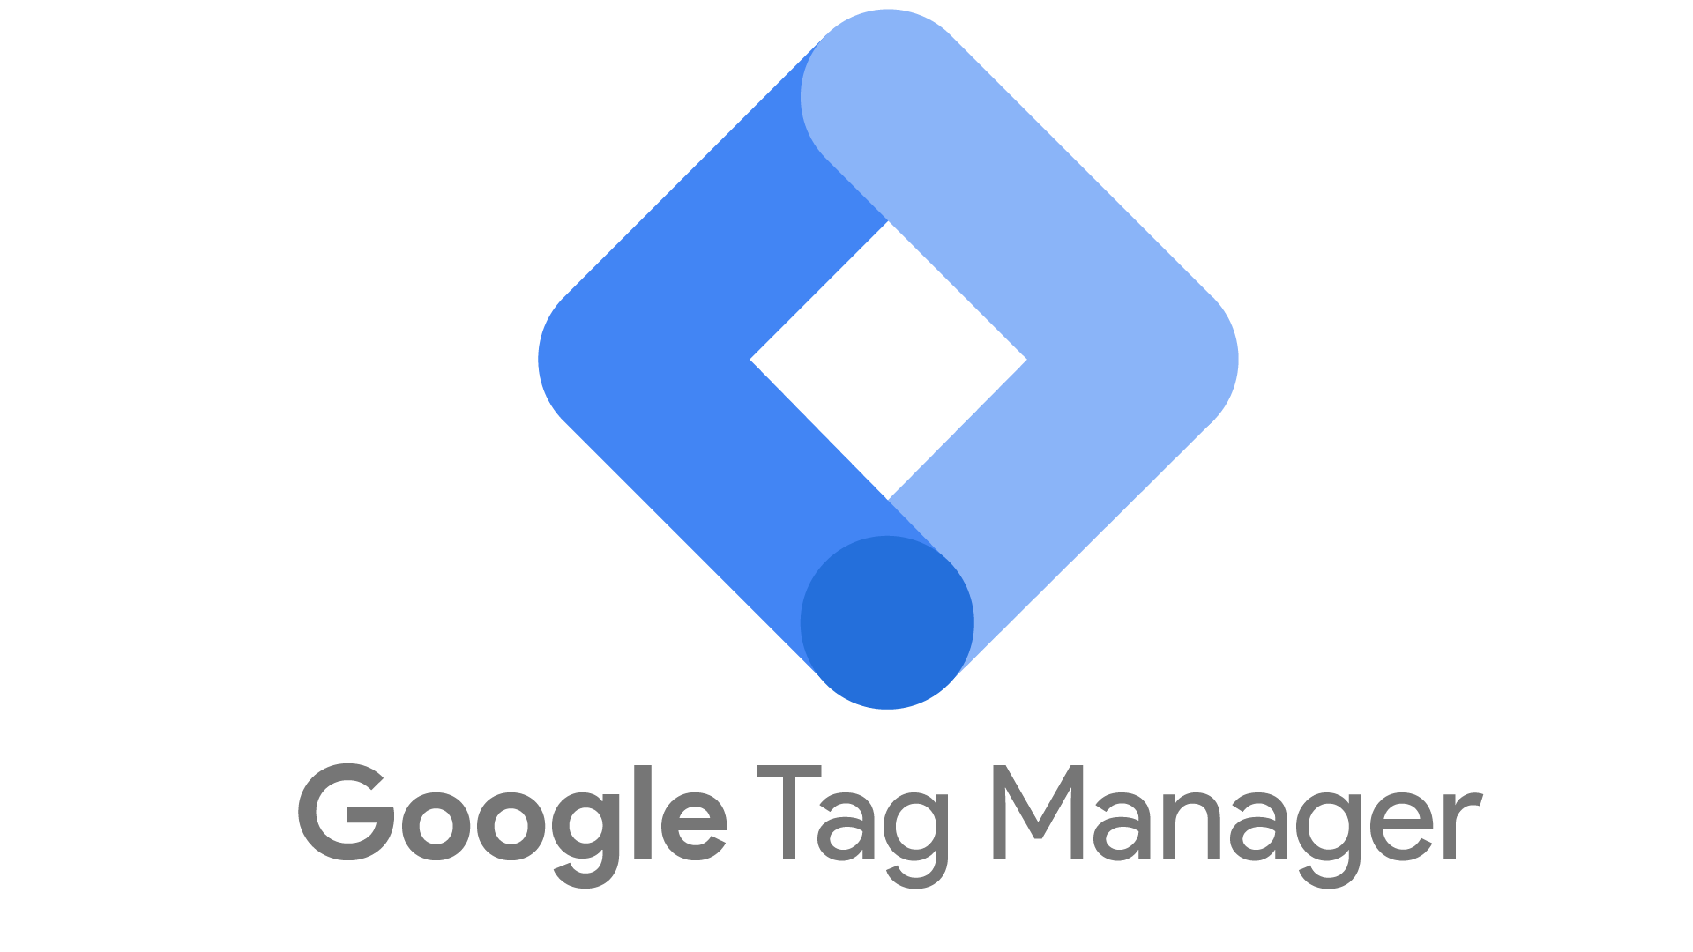
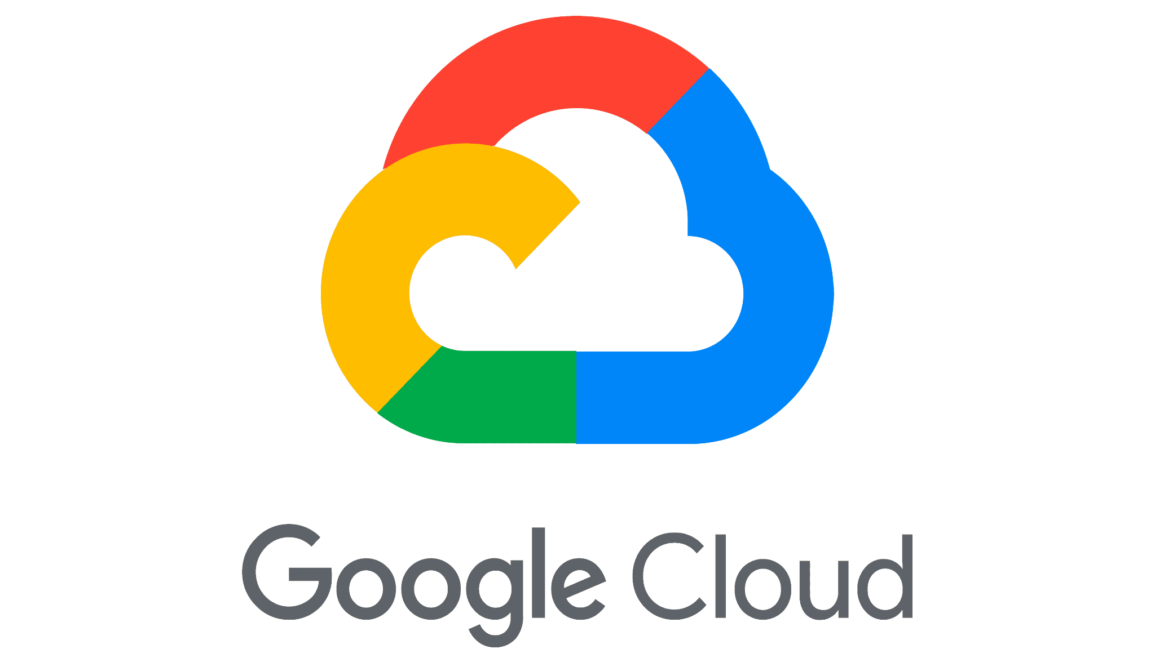

25-325
Plug & Play Clickstream Dashboard and Agent Event Tracker
Team members: Ben Aber, Hoang Le, Maxwell Goehle, Mohammed Ahmed | Faculty adviser: Rachita Sowle, Ph.D. | Sponsor: Capital One | Mentor: Mahesh Nair, Tyler Jordan, & Emily Croxall
Problem:
Stakeholders want an effective way to utilize clickstream data easily and efficiently to make changes to their applications. As a stakeholder it is essential to be able to improve an application quickly, based on user driven data. This needs to be accomplished without the need for strong technical skills.
Our Solution:
Collect user interactions, not inputs.
Store data through the cloud to allow for real time collection and analysis.
Convert clickstream data into actionable visualizations.
Create a portable design that can work with different clickstream data.
The Benefit:
Identify user trends within the data.
Scalable and reusable for future projects with different data.
Highlights under and over utilized features within the application, for improvement.
No technical skills required to have a customizable and interactive view of an applications clickstream data.
Streamlines decision making process for stakeholders.
Enhances user experience as data driven changes produce a more optimized navigation process.
Visual Dashboard
Design Flow:

